Slide 1

PES INSTITUTE OF TECHNOLOGY AND MANAGEMENT
Shivamogga-577204
Department of Information Science and Engineering
Title: Predictive Analysis and Forecasting of COVID-19 Outbreak
Under the Guidance of Project Coordinator Presented By
Mr. Vinay S K Dr. Pramod Akanksha J
Assistant Professor Associate Professor Akshatha S M
Rajeshwari M Hebballi

Slide 2
Outline
Page No.
Introduction 1
Problem Statement 2
Project Objectives 2
Literature Survey 3-4
Existing System 5
Proposed System 6
Methodology 7
Architecture 8
Programming Language 9
Libraries 10
Software Requirements 11
Hardware Requirements 12
Implementation 13-65
Conclusion 66
References 67-69

Slide 3
INTRODUCTION
In December 2019, the novel coronavirus appeared in the Wuhan city of China and was reported to the World Health Organization on 31st December 2019.
As of now the Active Cases all over the world is 1,29,81,236 and Death Cases are 37,52,212. And in India the Active Cases are 13,04,143 and Death Cases are 3,51,344.
With the help of datasets, Prediction and Forecasting techniques will be deployed to study the probable number of cases in the near future
1

Slide 4
PROBLEM STATEMENT
The Corona virus outbreak has already taken grip over people’s life. The question that we are trying to answer is “will it be able to tackle this COVID-19 pandemic”.
PROJECT OBJECTIVES
To Analyze and Visualize COVID-19 Data.
To Forecast the COVID-19 cases using Time Series Analysis.
To build a model that will predict the next n day’s Corona virus cases.
2

Slide 5
LITERATURE SURVEY
“Smart Weather Forecasting Using Machine Learning: A Case Study in Tennessee ”A H M Jakaria , Md Mosharaf Hossain , Mohammad Ashiqur Rahman , November 2018, Research Gate.
“The Research of Regression Model in Machine Learning Field ”Shen Rong, Zhang Bao-wen, 2018, IFID.
“Crime Prediction and Analysis Using Machine Learning” Alkesh Bharati1, Dr Sarvanaguru RA.K, Sep 2018, IRJET.
3

Slide 6
“Global Warming Prediction in India Using Machine Learning”, D. Deva Hema, Anirban Pal, Vineet Loyer, Rajeev Gaurav 2019, IJEAT.
“Predicting Heart Diseases in Logistic Regression of Machine Learning Algorithms By Python Jupyterlab” A. S. Thanuja Nishadi, Aug 2019, IJARP.
“Prediction of Rainfall Using Machine Learning Techniques”, Moulana Mohammed, Roshitha Kolapalli, Niharika Golla, Siva Sai Maturi, 01 January 2020, International Journal of Scientific & Technology Research.
4

Slide 7
EXISTING SYSTEM
Several outbreak prediction models for COVID-19 are being used by officials around the world to make informed decisions and enforce relevant control measures[1].
Due to a high level of uncertainty and lack of essential data, standard models have shown low accuracy for long-term prediction.
Although it includes several attempts to address this issue, the essential generalization and robustness abilities of existing models need to be improved[2].
5

Slide 8
PROPOSED SYSTEM
In our project, a step towards helping people to understand the spread and prediction of the covid-19 cases all over the World and in India will be done using Linear Regression Model.
Predictions are made with the help of dataset available.
This helps in deciding the preventive measures to be taken to control the pandemic
6

Slide 9
METHODOLOGY: BLOCK DIAGRAM
Data Collection
Data Preprocessing
Data Analysis and Visualization
Operationalize
Model Planning and Building
Result
7

Slide 10
ARCHITECTURE
Data
Cleaning
Data
Reduction
Data
Transformation
Testing
Samples
Data collection
Data Preprocessing
Preprocessed
Data
Machine Learning Algorithm
Building the Model
Testing
Prediction
Training
Samples
8

Slide 11
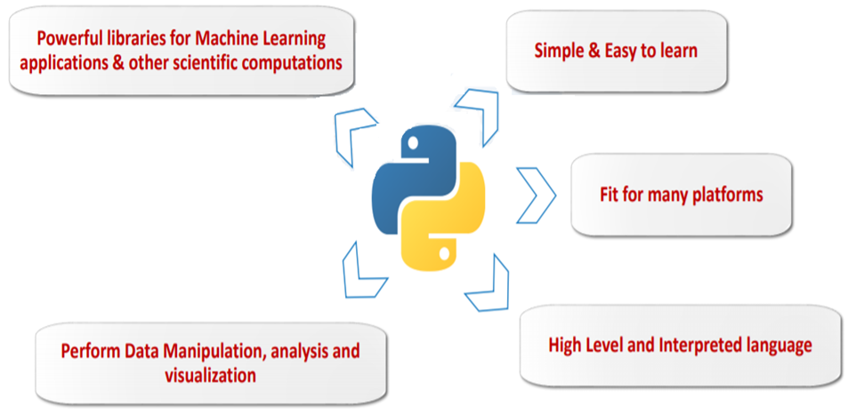
PROGRAMMING LANGUAGE: PYTHON
9

Slide 12
LIBRARIES
NumPy - Used for working with arrays which facilitate advanced mathematical and other types of operations on large numbers of data.
Pandas - Used for data manipulation and analysis, it offers data structures and operations for manipulating numerical tables and time series.
Matplotlib - Used for data visualization and graphical plotting.
Seaborn - It is a python data visualization library based on matplotlib. It provides a high-level interface for drawing attractive and informative statistical graphics.
Plotly - Interactive, open source and browser based graphic library for python.
10

Slide 13
SOFTWARE REQUIREMENTS
Operating system
Windows 7 or above
Web Application
Google Colaboratory
Web Browser
Google Chrome, Mozilla Firefox
11

Slide 14
HARDWARE REQUIREMENTS
Processor
i3 or above
RAM
2GB or above
Disk Space
2GB or above
12

Slide 15
IMPLEMENTATION
The implementation phase involves putting the project plan, idea, model, design, specification, algorithms into action.
Our project consists of several steps. They are as follows
1. Collection of Dataset
2. Data Preprocessing
3. Applying preprocessed data to the Algorithm
4. Building the model
5. Prediction
13

Slide 16
Collecting data is the first step in data processing. Data is pulled from available sources.
Once the data is collected, it then enters the data preparation stage. Data preparation, often referred to as “pre-processing”.
During preparation, raw data is checked for any errors. The purpose of this step is to eliminate bad data (redundant, incomplete, or incorrect data) and begin to create high-quality data to procure best results.
14

Slide 17
STEPS INVOLVED
Covid-19 Worldwide dataset is collected for analysis.
As mentioned before, Pandas, matplotlib, Seaborn, Numpy, Plotly libraries are imported.
import pandas as pd
import matplotlib.pyplot as plt
import seaborn as sns
import numpy as np
import plotly.express as px
Importing the dataset
path = 'https://raw.githubusercontent.com/datasets/covid- 19/main/data/countries-aggregated.csv‘
df = pd.read_csv(path)
df.head( )
15

Slide 18
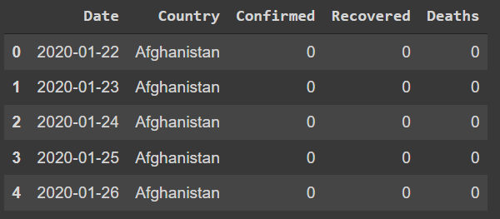
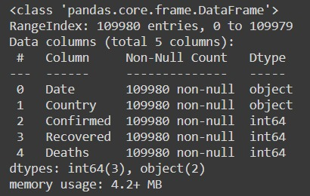
Checking the information of the data.
df.info()
Covid-19 Worldwide Dataset
Information of the data
16

Slide 19
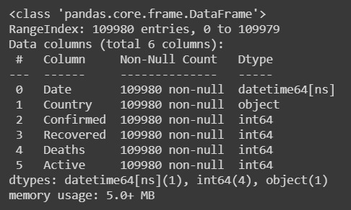
Transferring data into the required format.
df = pd.read_csv(path,parse_dates=['Date'])
Calculating the Active cases.
active = df['Confirmed'] - df['Recovered'] - df['Deaths']
df['Active'] = active
df.head()
Transformed data
17

Slide 20
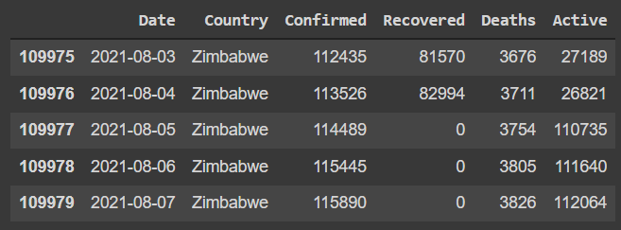
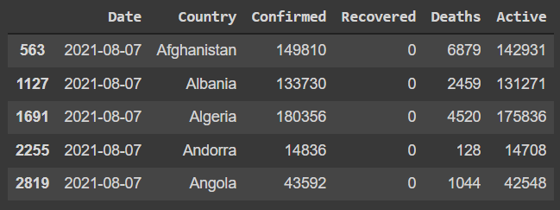
Displaying the latest date data
top = df[df['Date']== df['Date'].max()]
top.head()
Active cases column added to the dataset
18

Slide 21
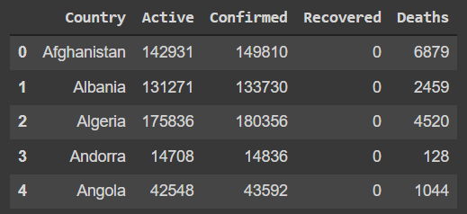
Removing the duplicate values and Resetting the Index
world = top. groupby('Country')['Active','Confirmed','Recovered', 'Deaths'].sum(). reset_index()
world.head( )
19

Slide 22
Data Visualization
Plotting Active, Confirmed, Recovered and Death cases on the world map
figure = px.choropleth(world,locations='Country',locationmode= 'country names',color='Active',hover_name='Country',range_col or=[1,2000],color_continuous_scale='purp',title='Countries With Active Cases')
figure.show()
20

Slide 23
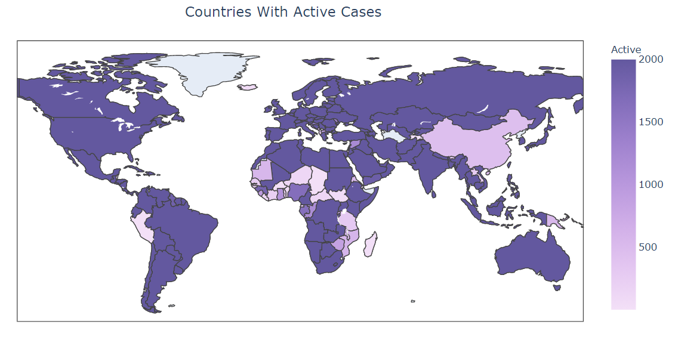
Total active cases plotted on World map
21

Slide 24
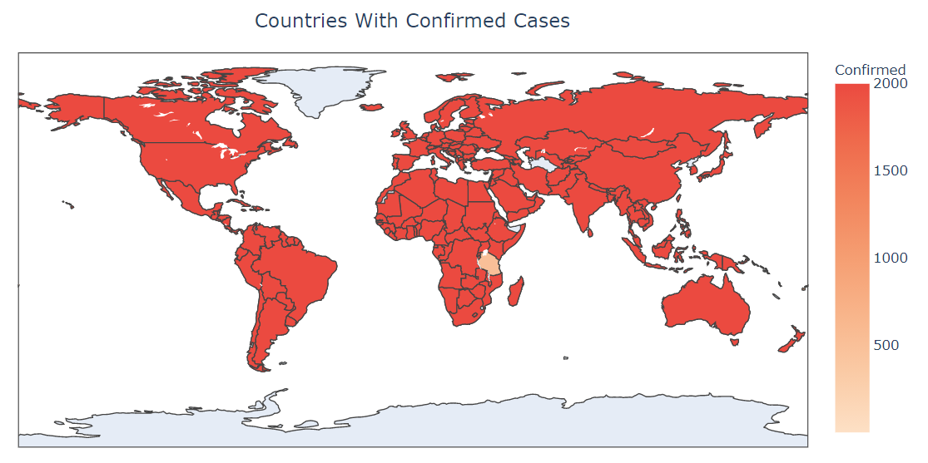
Total confirmed cases plotted on World map
22

Slide 25
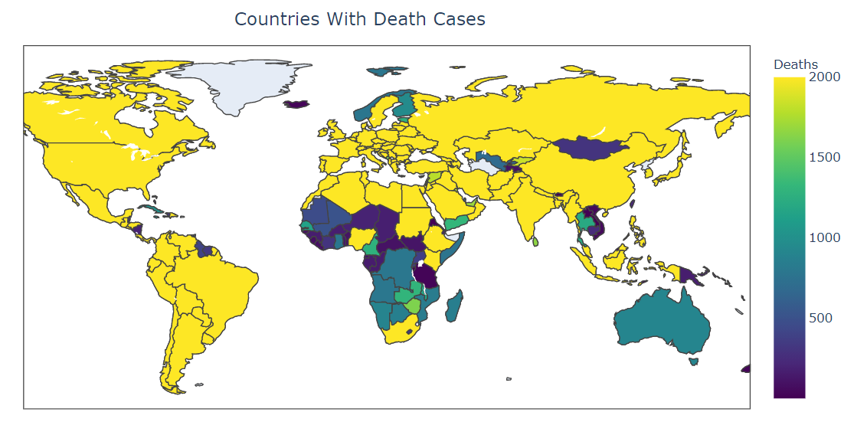
Total death cases plotted on World map
23

Slide 26
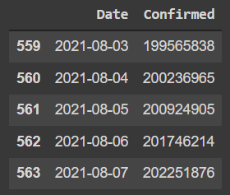
total_confirmed_cases = df.groupby('Date')['Date',‘Confirmed'].sum().reset_index()
total_confirmed_cases.tail()
plotting worldwide confirmed, recovered, and death cases over point plot.
plt.figure(figsize=(5,5))
plt.xticks(rotation=90,fontsize=10)
sns.pointplot(total_confirmed_cases['Date'].dt.date.tail(5),total_confirmed_cases[‘Confirmed'])
plt.show()
24

Slide 27
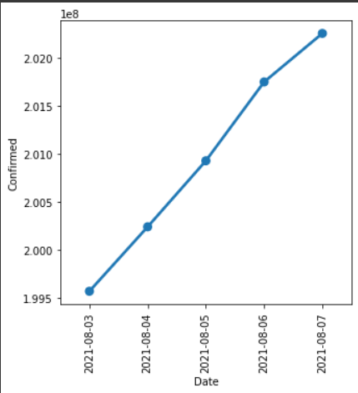
Date vs Total confirmed cases
25

Slide 28
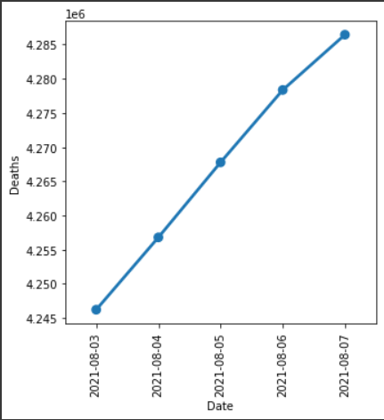
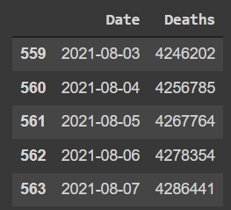
Date vs Total Death cases
26

Slide 29
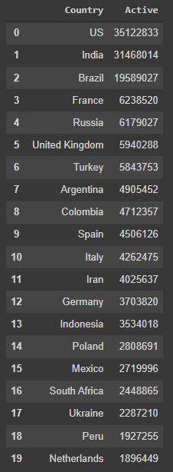
Top 20 Countries based on the total active cases. top_active = top.groupby('Country')['Active'].sum().sort_values (ascending=False).reset_index()
top_20_a = top_active.head(20)
top_20_a
Top 20 countries based on the total active cases
27

Slide 30
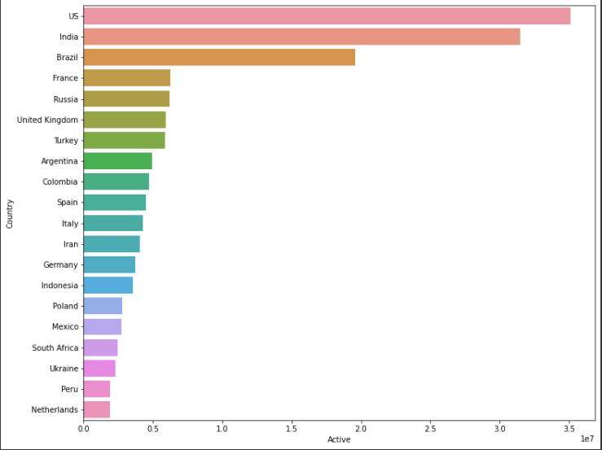
Plotting top 20 countries based on the total active cases on the bar plot
plt.figure(figsize=(12,10))
sns.barplot(top_20_a['Active'],top_20_a['Country'])
plt.show()
28
Active cases vs Top 20 countries

Slide 31
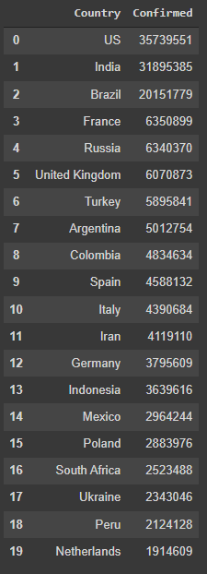
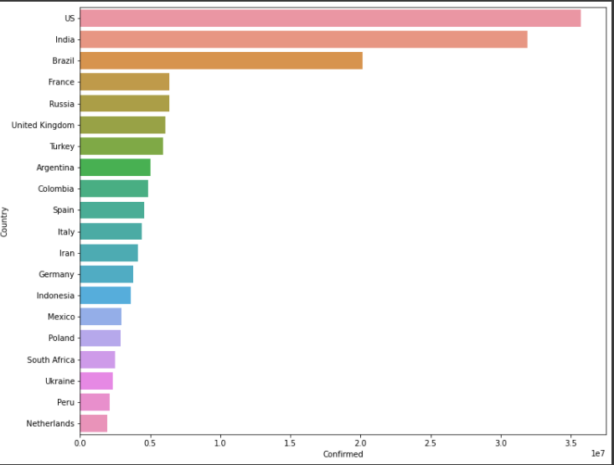
Confirmed cases vs Top 20 countries
29

Slide 32
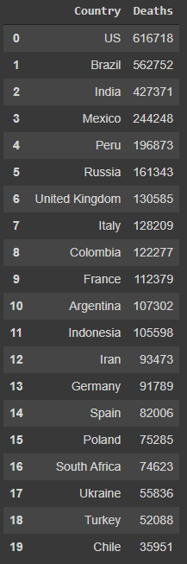
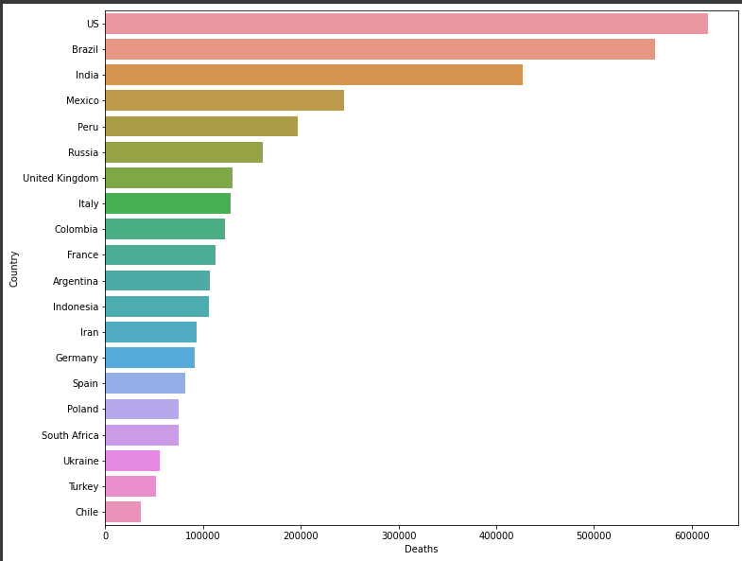
Death cases vs Top 20 countries
30

Slide 33
STEPS INVOLVED IN THE ANALYSIS OF INDIA’s DATASET
Covid-19 India’s dataset is collected for analysis.
Importing libraries
import pandas as pd
import matplotlib.pyplot as plt
import seaborn as sns
import numpy as np
import plotly.express as px
Importing the dataset
from google.colab import files
uploaded = files.upload()
import io
df = pd.read_csv(io.BytesIO(uploaded['C19India.csv']))
df.head()
31

Slide 34
Checking the format of data and transforming them
df.info()
df = pd.read_csv('C19India.csv',parse_dates=['Date'])
df.head()
Removing the unwanted column
df.drop (['ConfirmedIndianNational','Sno','ConfirmedForeignNational',
'Time'],axis = 1, inplace= True)
df.head()
Renaming the column
df.rename(columns ={"State/UnionTerritory":"State","Cured":"Recovered"} ,inplace=True)
df.head()
Calculating the active cases
active = df['Confirmed'] - df['Recovered'] - df['Deaths']
df['Active'] = active
df.head()
32

Slide 35
Sorting the values
data = df[['State','Confirmed','Active','Deaths','Recovered','Date']]
data.tail( )
data.sort_values('Active',ascending=False,inplace=True)
data.head( )
data.sort_values('Confirmed',ascending=False,inplace=True)
data.head()
data.sort_values('Recovered',ascending=False,inplace=True)
data.head()
data.sort_values('Deaths',ascending=False,inplace=True)
data.head()
df.tail( )
33

Slide 36
Forecasting the Confirmed Cases
Importing libraries
Import pandas as pd
Import matplotlib.pyplot as plt
Import seaborn as sns
Import numpy as np
Import plotly.express as px
Importing the dataset
Path=‘http”//raw.githubusercontent.com/datasets/covid19/main/datacount rieaggregated.csv’
df= pd.read_csv(path)
df.head()
34

Slide 37
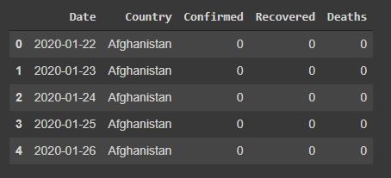
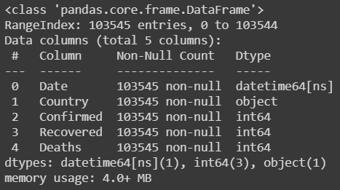
Checking the information of the data in the dataset and transforming the data
df.info()
df = pd.read_csv(path,parse_dates=['Date'])
df. tail()
35

Slide 38
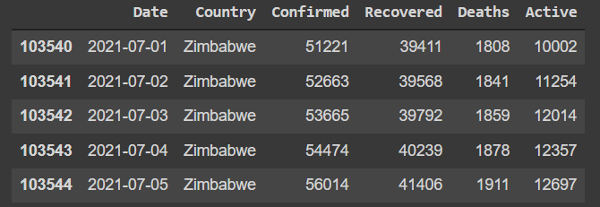
Adding new column Active
active = df['Confirmed'] - df['Recovered'] - df['Deaths']
df['Active'] = active
df.tail()
36

Slide 39
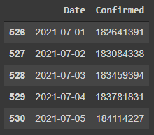
Displaying only the confirmed number of cases
confirmed = df.groupby('Date')['Confirmed'].sum().reset_index()
confirmed.tail()
37

Slide 40
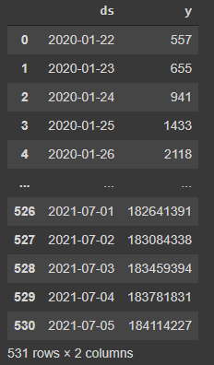
Importing fbprophet: a library created by facebook for the time series analysis
from fbprophet import Prophet
confirmed.rename(columns={'Date':"ds","Confirmed":"y"},inplace=True)
confirmed.
38

Slide 41
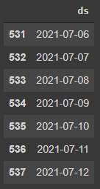
Building the model
model = Prophet(interval_width=0.95)
apply the model (train the model)
model.fit(confirmed)
future = model.make_future_dataframe (periods=7)
future.tail(7)
39

Slide 42
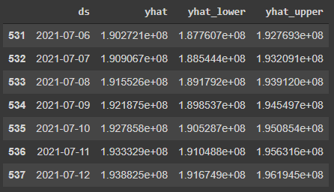
forecast=model.predict(future)
forecast[['ds','yhat','yhat_lower','yhat_upper']].tail(7)
40

Slide 43
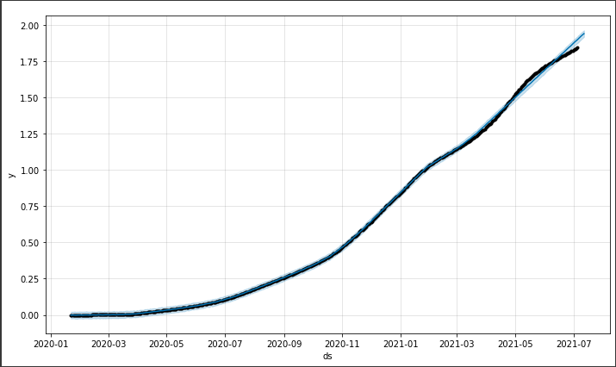
confirmed_plot = model.plot(forecast)
41

Slide 44
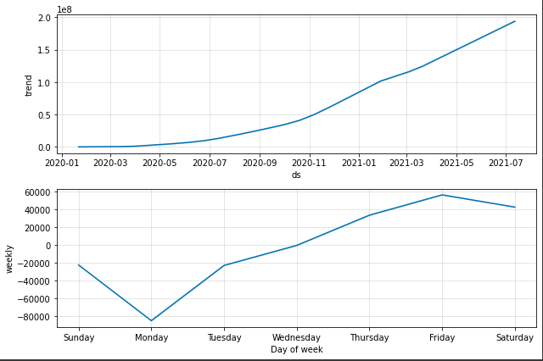
confirmed_plot_weekly=model.plot_components(forecast)
42

Slide 45
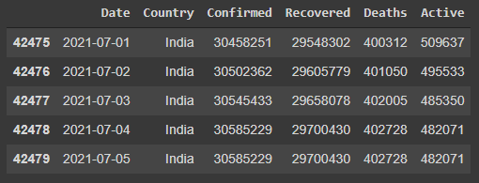
Forecasting the confirmed number of cases in India
df_india = df[df['Country']=='India']
df_india.tail()
43

Slide 46
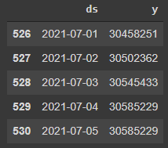
confirmed=df_india.groupby('Date'['Confirmed'].sum().reset_index()
confirmed.rename(columns={'Date':"ds","Confirmed":"y"},inplace=True)
confirmed.tail()
44

Slide 47
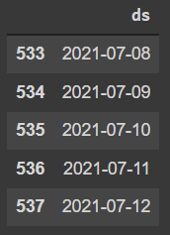
Building the Model
m = Prophet(interval_width=0.95)
m.fit(confirmed)
future = m.make_future_dataframe(periods = 7)
future.head()
45

Slide 48
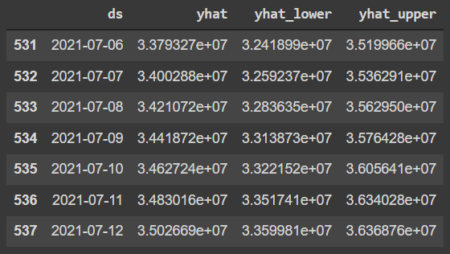
Forecasting
forecast = m.predict(future)
forecast[['ds','yhat','yhat_lower','yhat_upper']].tail(7)
46

Slide 49
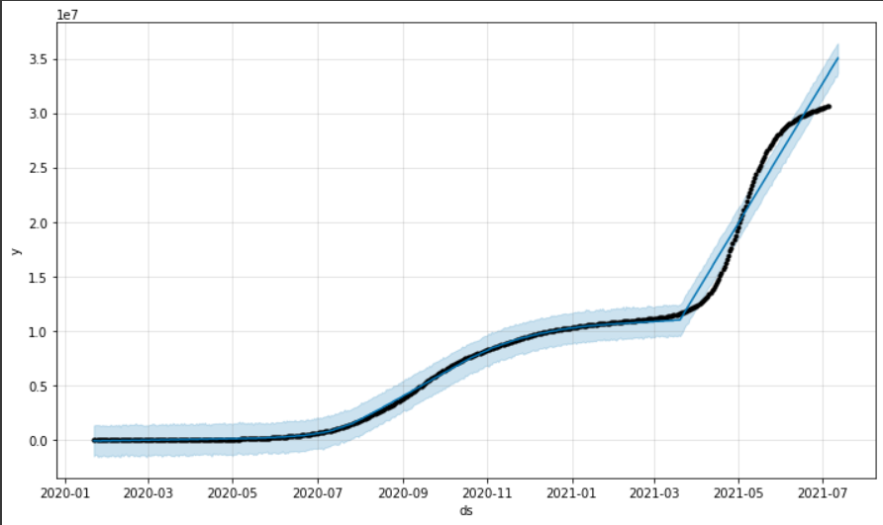
india_plot = m.plot(forecast)
confirmed_plot_weekly=m.plot_components(forecast)
47

Slide 50
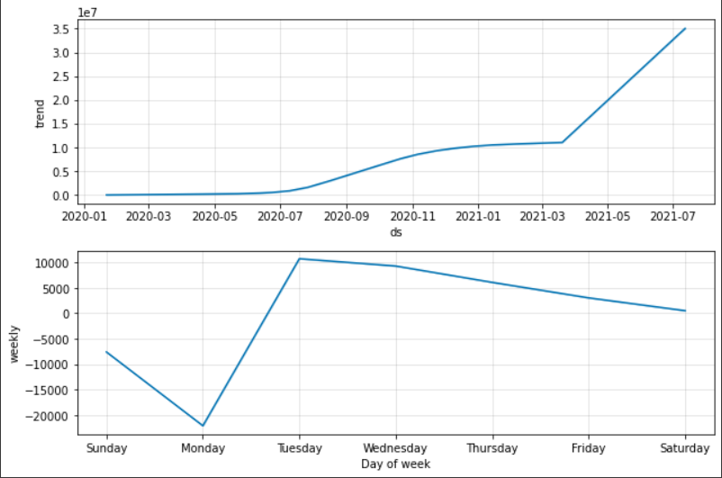
48

Slide 51
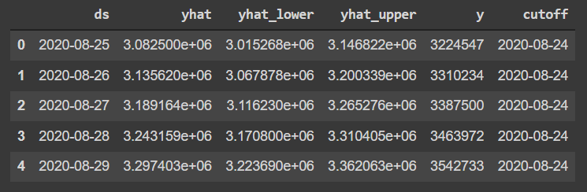
from fbprophet.diagnostics import cross_validation
df_cv=cross_validation(model=m,initial='180 days', horizon='90 days')
df_cv.head()
49

Slide 52
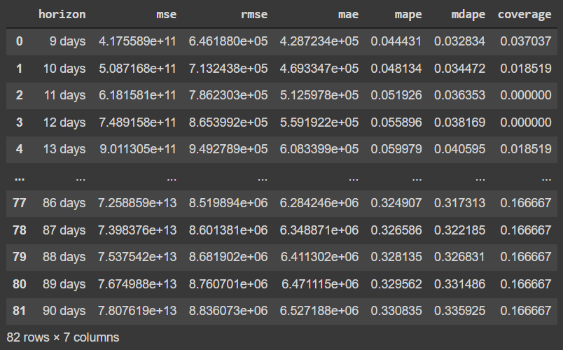
from fbprophet.diagnostics import performance_metrics
df_p= performance_metrics(df_cv)
df_p
50

Slide 53
Multivariate Forecasting
Importing the libraries
import pandas as pd
import matplotlib.pyplot as plt
import seaborn as sns
import numpy as np
import plotly.express as px
Path of the raw dataset
path = 'https://raw.githubusercontent.com/datasets/covid- 19/main/data/countries aggregated.csv'
df = pd.read_csv(path)
df.head()
51

Slide 54
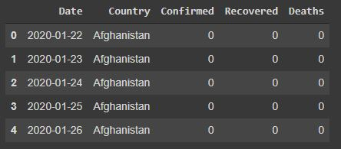
Checking the information of the data in the dataset
df.info()
converting data into date-time format
df = pd.read_csv(path,parse_dates=['Date'])
df.head()
52

Slide 55
Adding new column Active by calculating active
active = df['Confirmed'] - df['Recovered'] - df['Deaths']
df['Active'] = active
df.tail()
53

Slide 56
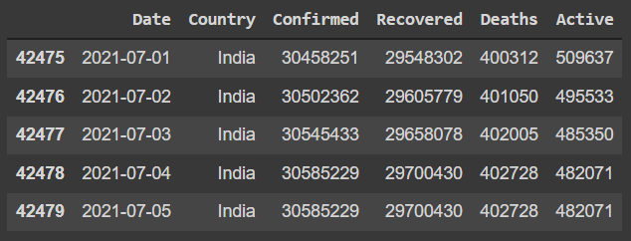
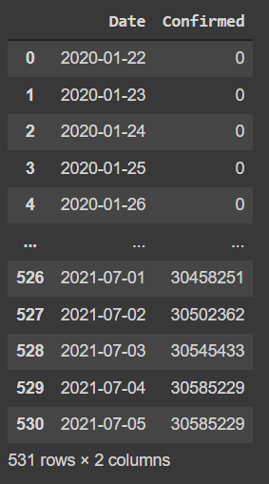
df_india = df[df['Country']=='India']
df_india.tail()
df_india.groupby('Date')['Confirmed'].sum().reset_index()
54

Slide 57
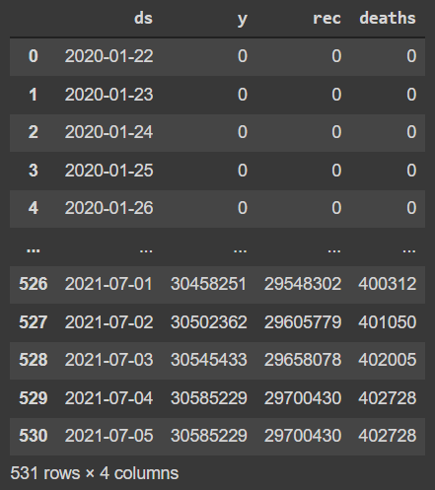
confirmed=df_india.reset_index()[['Date','Confirmed','Recovered','Deaths']].rename({'Date':'ds','Confirmed':'y','Recovered':'rec','Deaths':'d
55

Slide 58
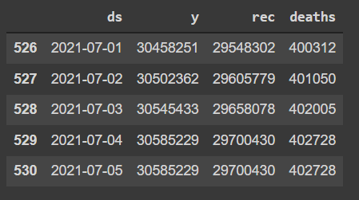
train=confirmed[(confirmed['ds']>='2020-01-22') & (confirmed['ds'] <='2021-03-15')]
test=confirmed[(confirmed['ds']>'2021-03-15')& (confirmed['ds'] <='2021-06-26')]
train.shape (419, 4)
test.shape (112, 4)
test.head()
56

Slide 59
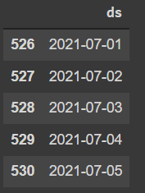
Importing Prophet
from fbprophet import Prophet
Building the Model
m = Prophet(interval_width=0.95)
m.add_regressor('rec',standardize=False)
m.add_regressor('deaths',standardize=False
m.fit(train)
m.params
future=m.make_future_dataframe(periods=112)
future.tail()
57

Slide 60
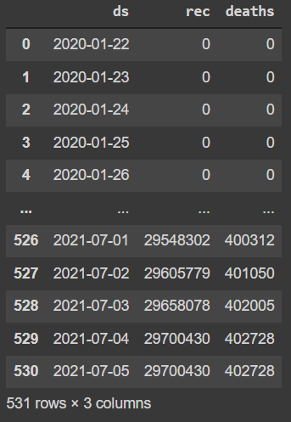
future['rec']=confirmed ['rec']
future['deaths']=confirmed ['deaths']
future
58

Slide 61
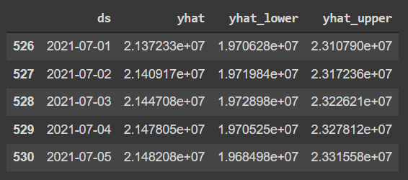
forecast = m.predict(future)
forecast[['ds','yhat','yhat_lower','yhat_upper']].tail()
59

Slide 62
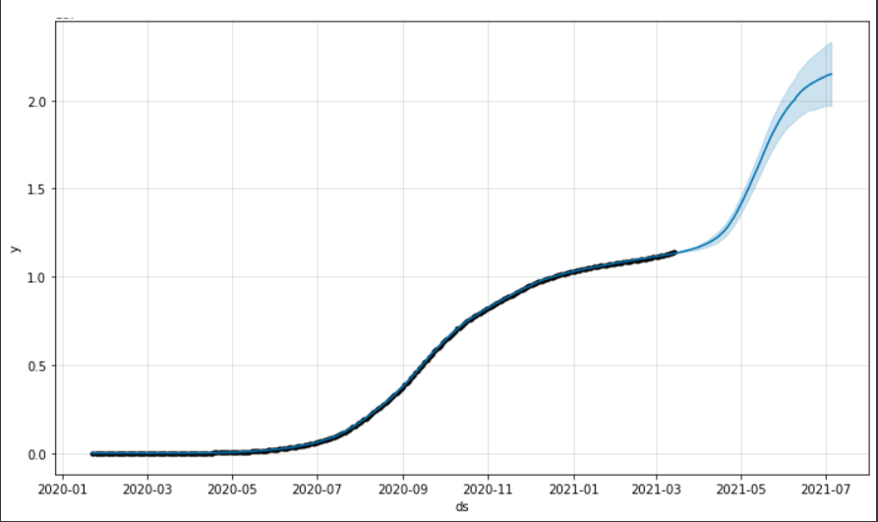
fig1=m.plot(forecast)
fig2=m.plot_components(forecast)
Fig: Multivariate Plot
60

Slide 63
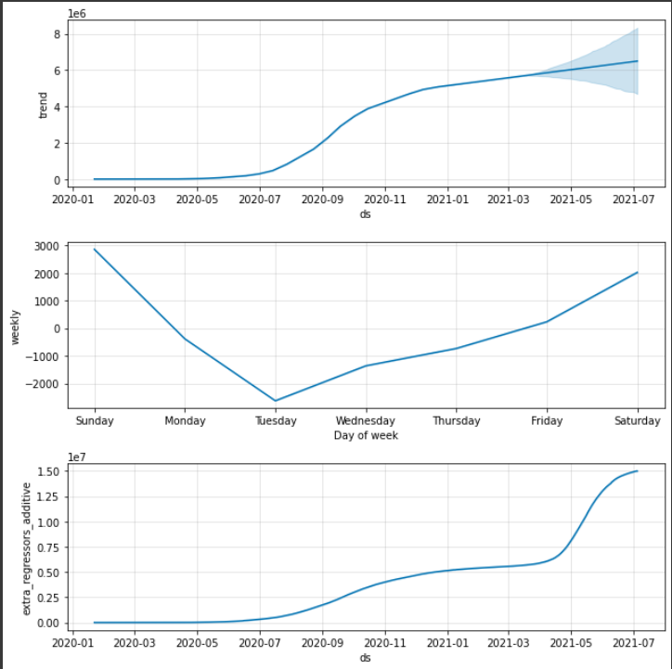
Fig: Trend component
61

Slide 64
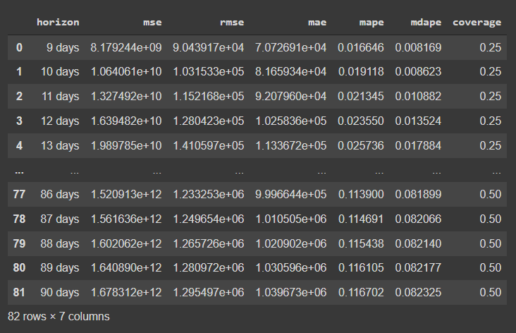
from fbprophet.diagnostics import cross_validation, performance_metrics
df_cv=cross_validation(model=m,initial='180 days', horizon='90 days')
df_p=performance_metrics(df_cv)
df_p
62

Slide 65
CONCLUSION
This project helps in the analysis of COVID-19 data and the pandemic spread is compared between different countries. Data Visualization technique is performed to give a clear look on how the virus is spreading, which countries are getting affected mostly and how different countries are recovering. On applying Linear Regression Model and Multivariate Regression Model the possible number of COVID-19 cases is pertained.
63

Slide 66
REFERENCES
Ashutosh kumar, “COVID 19: Analysis, Prediction, Plotting”, June 2020, ResearchGate.
Mohammadreza Nemati, Jamal Ansary, Nazafarin Nemati,“Machine-Learning Approaches in COVID-19 Survival Analysis and Discharge-Time Likelihood Prediction Using Clinical Data”,4 July 2020, ScienceDirect.
Yazeeb zoabi Shira Deri rozov and Noam shomron, “Machine learning-based prediction of COVID-19 diagnosis based on symptoms”, January 2021,npj digital medicine.
R. Sujath, Jyotir Moy Chatterjee & Aboul Ella Hassanien, “A machine learning forecasting model for COVID-19 pandemic in India”, July 2020, Springer link.
Rajan Gupta, Gaurav PandeyPoonam Chaudhary, Saibal K. Pal, “Machine Learning Models for Government to Predict COVID-19 Outbreak”, Aug 2020, ACM digital library.
64

Slide 67
Othman Istaiteh, Tala Owais, Nailah Al-Madi Saleh Abu-Soud, “Machine Learning Approaches for COVID-19 Forecasting”,2020 International Conference on Intelligent Data Science Technologies and Applications (IDSTA).
Dr. Vakula Rani J, Aishwarya Jakka, “Forecasting COVID-19 cases in India Using Machine Learning Models” , July 2021, International Conference on Smart Technologies in Computing, Electrical and Electronics (ICSTCEE 2020).
Saud Sheikh, Jaini Gala, Aishita Jain, Sunny Advani, Sagar Jaidhara, “Analysis and Prediction of Covid-19 using Regression models and Time series Forecasting”, 2021, 11th International Conference on Cloud computing, Data Science and Engineering(Confluence 2021).
Ovi Sarkar, Md Faysal Ahamed, Pallab Chowdhury, “ Forecasting & Severity Analysis of COVID-19 Using Machine Learning Approach with Advanced Data Visualization” , Dec 2020, 23rd International Conference on Computer and Information Technology (ICCIT).
Furqan Rustam, Aijaz Ahmad Reshi 2, Arif Mehmood,Saleem Ullah ,Byung-Won On, Waqar Aslam,And Gyu Sang Choi, “COVID-19 Future Forecasting Using Supervised Machine Learning Models” ,June 2020, National Research of Korea (NRF) grant funded by Korea government (MSIT).
65

Slide 68
Zhihao Yang,Kang’an Chen, “Machine Learning Methods on COVID-19 Situation Prediction” ,2020 ,International Conference on Artificial Intelligence and Computer Engineering (ICAICE).
Vartika Bhadana, Anand singh jalal, Pooja pathak, “A comparitive study of Machine Learning methods for Covid-19 prediction in India”,2020.
Deepak Painuli, Divya Mishra, Suyash Bhardwaj,Mayank Aggarwal, “Forecast and prediction of COVID-19 using machine learning” ,2021, Elseveir Public health Emergency Collection.
Md. Shahriare Satu, Koushik Chandra Howlader, Mufti Mahmud, M. Shamim Kaiser ,Sheikh Mohammad Shariful Islam , Julian M. W. Quinn , Salem A. Alyami and Mohammad Ali Moni , “ Short-Term Prediction of COVID-19 Cases Using MachineLearning Models” , 2021, MDPI
Sina F. Ardabili,Amir Mosavi,Pedram Ghamisi,Filip Ferdinand,Annamaria R.Varkonyi-Koczy, Uwe Reuter,Timon Rabczuk,Peter M. Atkinson, “ COVID-19 Outbreak Prediction with Machine Learning”, 2020.
66

Slide 69
THANK YOU

